Slide 1

Securing understanding of perimeter and area
Task A: Calculating the perimeter and area of rectangles
1) Jun wants to work out the area and perimeter of each of these rectangles.
a) Which rectangles have “enough”, “too much”, or “not enough” information?
X: Not enough, need the length of a shorter side Y: The right amount, the other sides can be deduced Z: Too much, need two non-parallel sides
b) Find the area and perimeter of the rectangles where possible.
For shape Y
Perimeter = 25 + 25 + 6 + 6 Area = 25 × 6 = 62 m = 150 m²
For shape Z
Perimeter = 40 + 40 + 40 + 40 Area = 40 × 40 = 160 mm = 1600 mm²
c) Jun works out the area of Z using the calculation 40 × 40 × 40 × 40. What have they done wrong?
They have multiplied every length together instead of multiplying the length by the width.
40 mm
25 m
13 cm
X
13 cm
Y
6 m
40 mm
Z
40 mm
40 mm

Slide 2
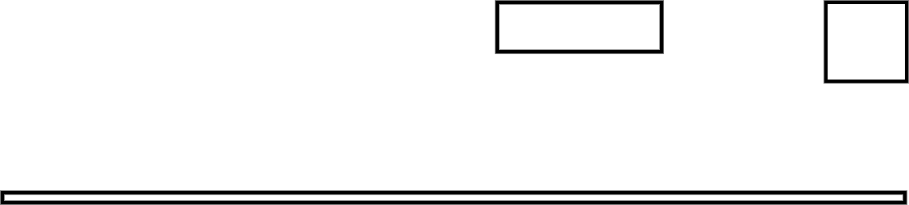
Securing understanding of perimeter and area
Task B: Identifying a rectangle from its perimeter
1) Laura wants to buy a plot of land to build a house. The table below shows some information about the plots.
Plot | Area (m²) | Perimeter (m)
X | 100 | 40
Y | 120 | 242
Z | 120 | 52
a) Which plot do you think they should choose?
Any plot may be selected here
By the table are plan views of the three plots.
b) Match each image to a row in the table.
X = Yellow; Y = Blue; Z = Red
c) Explain whether you wish to change your answer to part A.
Answers will vary here depending on the original plot chosen
Plot | Area (m²) | Perimeter (m)
X | 100 | 40
Y | 120 | 242
Z | 120 | 52
20 m
10 m
6 m
Red
10 m
Yellow
120 m
Blue

Slide 3

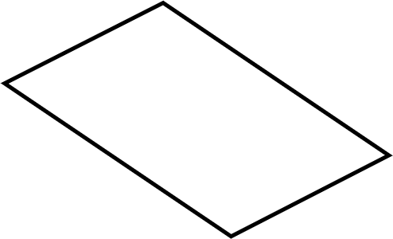
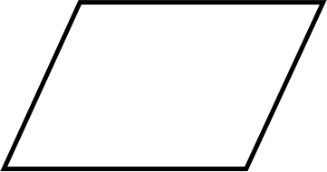
Securing understanding of perimeter and area
Task C: The area of a parallelogram
1) Calculate the area of each parallelogram.
a) b)
10 m
7.3 cm
8 cm
8 m
4 m
0.7 cm
Area = 0.7 × 7.3 = 5.11 cm²
Area = 8 × 10 = 80 m²
c) The area of parallelogram is 36 units².
Calculate the size of the missing length and add it to the diagram.
36 = base × 10 3.6 = base
The base should be marked parallel to the indicated line.
12
10
base
Mathematics in Education and Industry.

